Slide 1
KEY RELATIONSHIPS
Scorecard: (Supplier-ID⁸, FID¹⁹, Supplier-name, Aerospace/ Defense, Avg, 1st-half, 2nd-half, Quality, OTD, Price, CService_Ranking, SNCR-Qty, DPM (defective per million), OTD%, CAction#¹⁷, PAction#¹⁶)
Supplier_Order : (Supplier OID, Supplier-ID⁸, SID⁴, PartID²⁸, MatID⁹, Quantity, Notes, Purchased_Date, Due_Date, Price_Per_Unit, Total)
Scorecard table records all the attributes that show on the scorecard. Future implementation will be recorded on CAction# and PAction#

Slide 2
KEY RELATIONSHIPS
Work Order Details ( WID⁵, MID²⁶, FID¹⁹, EID⁷, Date, Sequence, Time In, Time Out )
Employee (EID, Supervisor ID Last, First, SSN, Department, Salary, Commission, Hourly Wage)
Supplier: (Supplier-ID, Company-name, Address, Contact, Title, Phone/Fax, Scope, ISO?(certificated?), Aerospace or ITAR)
Material: (MatID, Supplier-ID⁸, Material-name, Description, Expiration-date)
Supplier Contact: (EID⁷, Lname, MI, Fname, E-mail, Phone #)
Work Order Details table describes the detailed time frame and sequence number for each work order for the specific machine, factory.

Slide 3
KEY RELATIONSHIPS
Reject Code: (CodeID, Year, Reject Reason, Number of reject Code)
Preventive Action (PAction#,Supplier-ID⁸, CID¹,CodeID¹⁵, Date, Quantity Value)
Corrective Action (CAction#,Supplier-ID⁸, CID¹, CodeID¹⁵, Date, Quantity Value)
Facility_Produced_Parts(FID¹⁹, PartID²⁸ )
Facility(FID¹⁹, Location,Num_Employees, Operating_Days, Operating_Hours)
Corrective Action table records the quantity value the suppliers return to us. It’s used to keep check of the performance of the suppliers so that we can better determine the scorecard

Slide 4
NORMALIZATION
V

Slide 5
NORMALIZATION
Scorecard(Supplier-ID⁸, FID¹⁹, Supplier-name, Aerospace/ Defense, Avg, 1st-half, 2nd-half, OTD, Price, CService_Ranking, SNCR-Qty, DPM (defective per million), OTD%, CAction#¹⁷, PAction#¹⁶)
Normalized into 1NF: Normalized into 2NF:
Scorecard(Supplier-ID⁸, FID¹⁹, Supplier-name, Aerospace/ Defense, Avg, 1st-half, 2nd-half)
Quality(Supplier-ID⁸, FID¹⁹, Quality1, Quality2)
OTD(Supplier-ID⁸, FID¹⁹, OTD1, OTD2)
Price(Supplier-ID⁸, FID¹⁹, Price1, Price2)
CService_Ranking(Supplier-ID⁸, FID¹⁹, CService_Ranking1, CService_Ranking2)
SNCR-Qty(Supplier-ID⁸, FID¹⁹, SNCR-Qty1, SNCR-Qty2)
DPM (defective per million) (Supplier-ID⁸, FID¹⁹,DPM1, DPM2)
OTD%(Supplier-ID⁸, FID¹⁹, OTD%1, OTD%2)
Supplier_name(Supplier-ID⁸, Supplier_name)
Supplier_type(Supplier-ID⁸, Aerospace/Defense)
Normalized into 3NF:
Supplier_Avg Score(1st-half, 2nd-half, Avg)
Supplier_Semi-Annual Score(OTD, Price, CService_Ranking, SNCR-Qty, 1st-half, 2nd-half)
Supplier_OTD Ranking(OTD%, OTDScore)
Supplier_Quality(DPM (defective per million), SNCR-Qty, QualityScore)

Slide 6
QUERIES
VI

Slide 7
QUERY I
To Optimize the Production Cost for a Specific Part on a order
Analyze machine capacity
Determine production schedule
Optimize the production cost

Slide 8
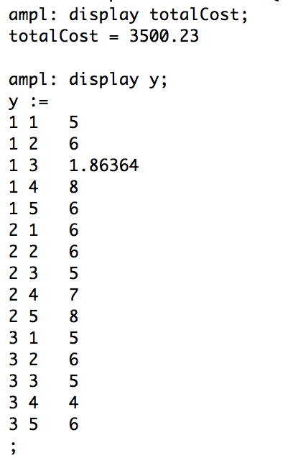
TECHNICAL DETAILS
SQL
Retrieves the MachineID, efficiencies and operational costs of machines that are able to make the specific part
AMPL
Find the optimal schedule for each machine, about how much hour for each machine to produce
OUTPUT

Slide 9
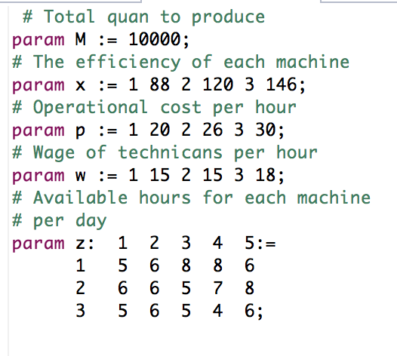
TECHNICAL DETAILS
Assumption:
Produce 10000 pieces for part 12 in 5 days
Know the number of available hours for each machine in each day

Slide 10
TECHNICAL DETAILS
SQL
Create table
Select MID, Efficiency
From Machine_Makes_Part
Where PartID=12 and FID=4;

Slide 11
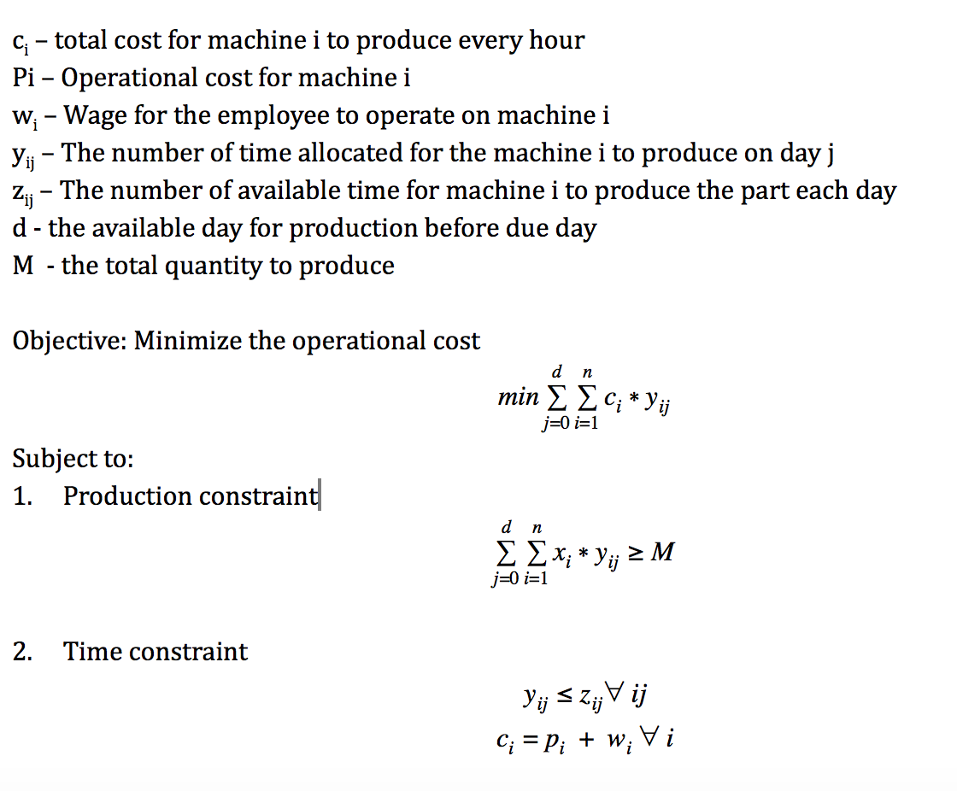
TECHNICAL DETAILS
AMPL :
Based on the given available hours, the efficiency, the cost for each machine
To generate a schedule for each machine to minimize the production cost

Slide 12
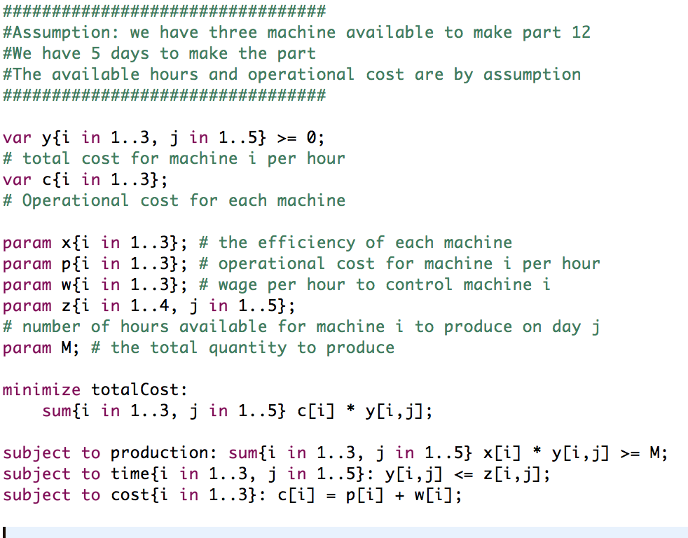
TECHNICAL DETAILS
CODE

Slide 13
QUERY II
Calculated the right amount of material to buy from a specific supplier to produce a part by calculating the 95% Confidence Interval for the defective rate of that supplier
Analyze Supplier’s performance
Predict the defective rate
Optimize the production cost

Slide 14
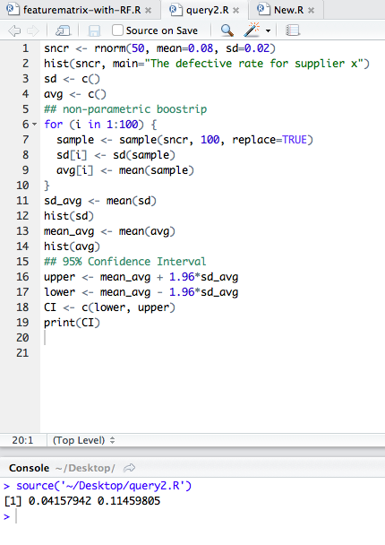
TECHNICAL DETAILS
SQL
Generate a table for the material needed for the production and its supplier
Generate a table to find percentages of defective products from all historical supply orders for that supplier
ANALYSIS
Load all the info generated from SQL to Rstudio. Using bootstrap to calculate the standard error and predict the 95% CI Determine how much materials we should purchase from the supplier
OUTPUT & CODE

Slide 15
TECHNICAL DETAILS
SQL 1
Create table Parts as Select m.MatID, po.Quantity * pm.Quantity, m.Supplier-ID From Purchase Order as po, Production Model as pm, Material as m Where po.PID=30 and pm.MatID=99 and pm.PID=po.PID and m.MatID=pm.MatID;
SQL 2
Create table Supplier_performace as Select SNCR.supplier-ID, SNCR.Reject quantity/p.quantity From SNCR Log as SNCR, Purchase Order as p, PARTS as pa Where SNCR. Supplier-ID=pa. Supplier-ID and SNCR.PID=p.PID;

Slide 16
QUERY V
Determine which department of Boyd has had the most occurrences of errors
Group top defects found in NCR log
Separate based off on reject code initial letter
Graph and compare to all departments

Slide 17
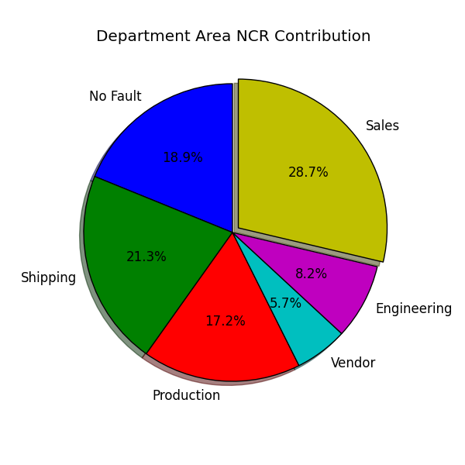
SQL
Create tables looking through Boyd NCR log and prioritizing high value errors (> 15%)
Count the number of occurrences of these high value errors by returning Reject defect Codes
Analysis
Import data from sql into matlab and run a loop to check initial letters from reject codes collected. The initial letter of the reject codes identifies which department was at fault.
Output

Slide 18
TECHNICAL DETAILS
SQL
select count(s.SNCR#), s.CodeID
from sncr as s, purchase order as p
where s.rejectqty/p.qty > .15
and s.rejectqtyval/p.totalsalevalue > .15
and p.pid = s.pid
select count(c.CNCR#), c.CodeID
from cncr as c, sales order as so, purchase order as p
where c.rejectqty/p.qty > .15
and c.rejectqtyval/p.totalsalevalue > .15
and p.pid = so.pid
and so.sid = c.sid
select count(ip.IPNCR#), ip.CodeID
from IPNCR as ip, Work Order as w
Sales order as so, Purchase Order as p
where ip.rejectqty/p.qty > .15
and ip.rejectqtyval/p.totalsalevalue > .15
and p.pid = so.pid
and so.sid = w.sid
and w.wid = ip.wid

Slide 19
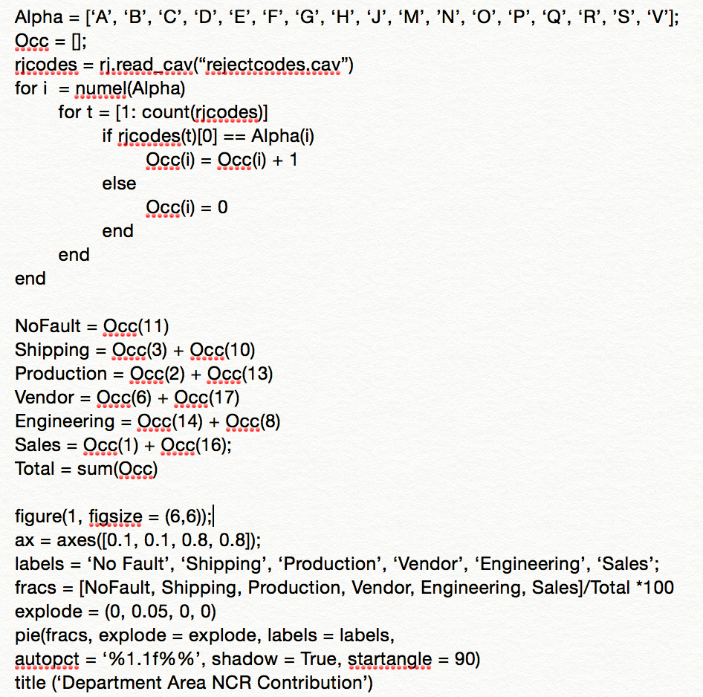
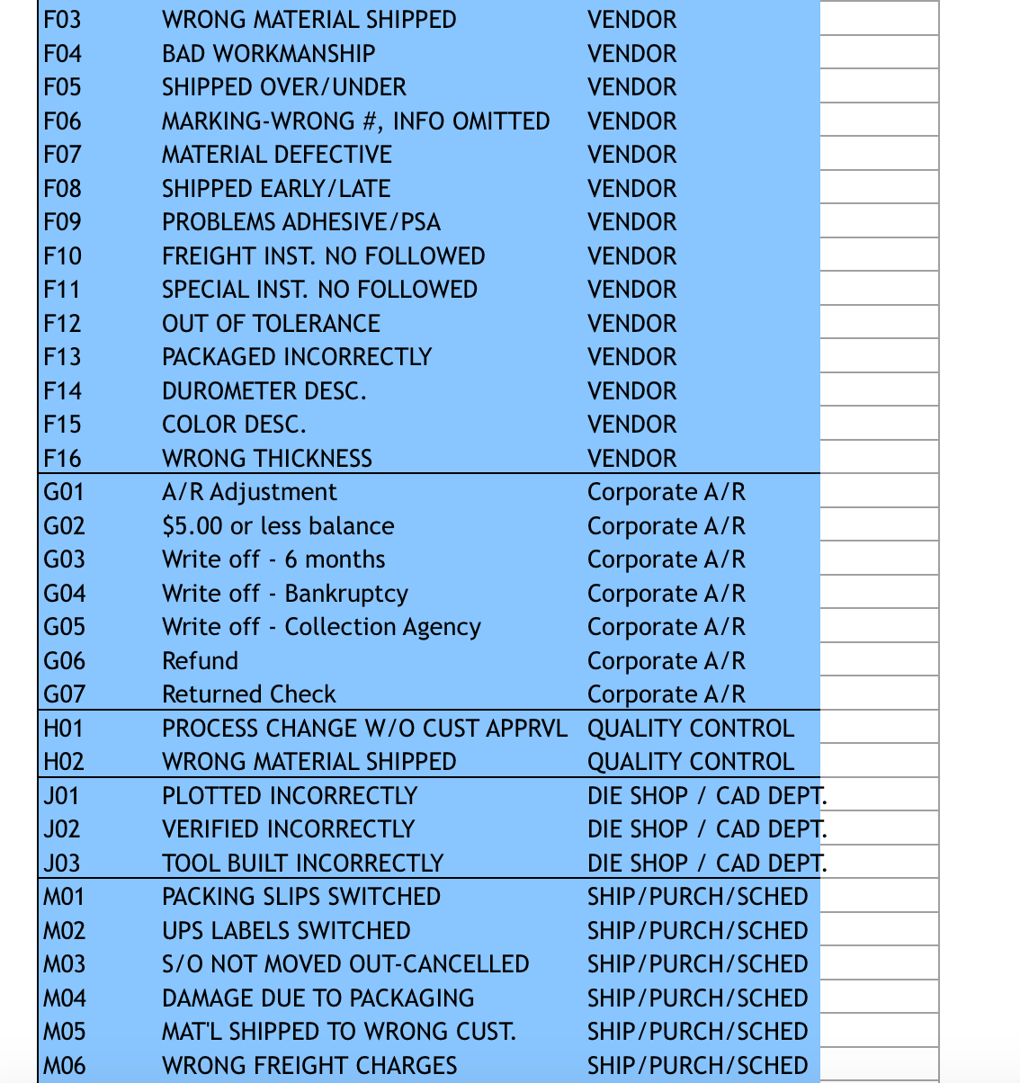
Justification:
Quality Assurance:
Identifying system issues in order to prevent and avoid common root problems encountered in Boyd departments.
Helps Boyd set goals in each department to minimize errors
Formula:
f_{i} = f/n
Find frequency percentage of occurrences of defective parts
Reject Defect Codes:
Code:

Slide 20
THANK YOU!

